Slide 1


Introduction to Bootstrap
L01 – Fits All Sizes
C273 – Advanced Web Application Development in PHP

Slide 2

Bootstrap (open-source CSS framework) merits #1
Mobile first approach: Since Bootstrap 3, the framework consists of Mobile first styles throughout the entire library instead of in separate files.
Browser Support: It is supported by all popular browsers.
Easy to get started: With just the knowledge of HTML and CSS anyone can get started with Bootstrap. Also the Bootstrap official site has a good documentation.

Slide 3

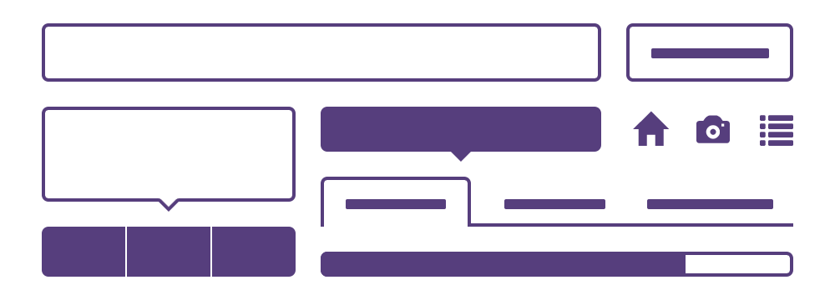
Bootstrap (open-source CSS framework) merits #2
Responsive design: Bootstrap's responsive CSS adjusts to Desktops,Tablets and Mobiles.
Contains beautiful and functional built-in components which are easy to customize
Open source

Slide 4
Bootstrap 4
v4 is now only IE10+ and iOS 7+
Added official support for Android v5.0 Lollipop’s Browser and WebView

Slide 5
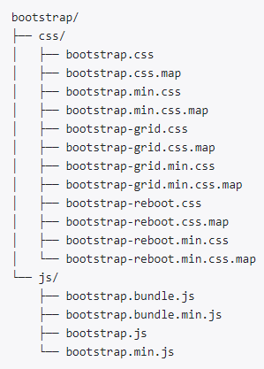
Structure of Bootstrap 4
Download Bootstrap distributable from http://getbootstrap.com/getting- started/
Use the precompiled minified versions bootstrap.min.*

Slide 6
5 basic Bootstrap components in a HTML page
✓
Put this at top of HTML page as Bootstrap makes use of certain HTML elements and CSS properties that require the use of the HTML5 doctype
Ensure proper rendering and touch zooming on mobile devices by adding:
Add Bootstrap cascading stylesheet
Add Bootstrap javascript library
Ensure proper centering and maximum width for layout by adding:

Slide 7
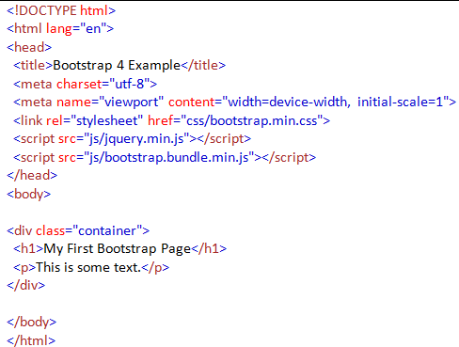
Basic Bootstrap HTML page

Slide 8
4 basic Bootstrap Features
Bootstrap has loads of predefined classes and components, these include:
Responsive Grid System
Navigation
Themes customisation
Form controls

Slide 9
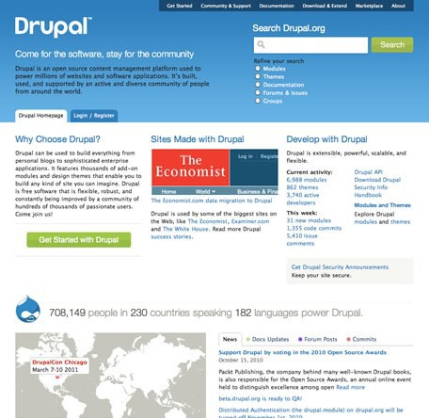
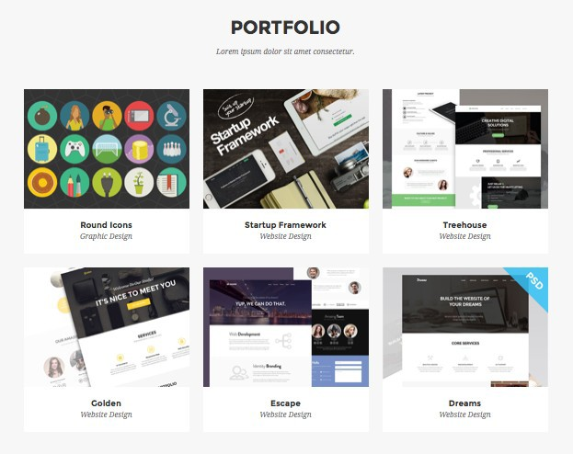
What is grid in web design?

Slide 10
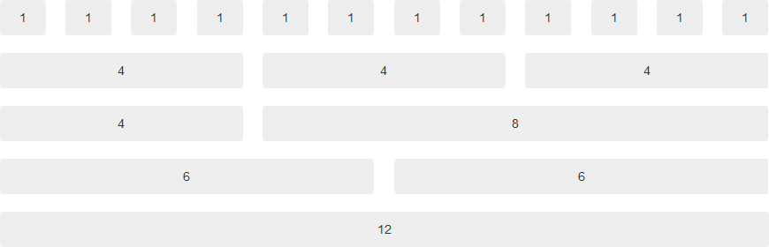
Grid System
Bootstrap includes a responsive, mobile first fluid grid system
Appropriately scales up to 12 columns as the device or viewport size increases.

Slide 11
5 Sizes of Bootstrap 4
Grid | Extra small (<576px) | Small (>=576px) | Medium (>=768px) | Large (>=992px) | Extra Large (>=1200px)
Class prefix | .col- | .col-sm- | .col-md- | .col-lg- | .col-xl-
Container width | None (auto) | 540px | 720px | 960px | 1140px
Suitable for | Portrait phones | Landscape phones | Tablets | Laptops | Laptops and Desktops

Slide 12
Grid System: Examples
Size is combined with Grid
<div class="row">
<div class="col-md-4" >……</div> <!--Medium ,720px,tablet-->
<div class="col-md-8" >……</div>
</div>
<div class="row">
<div class="col-md-12" > Level 1 column
<div class="row">
<div class="col-md-6" > Level 2</div> <!--Medium ,720px,tablet-->
<div class="col-md-3" > Level 2</div>
</div>
</div>
</div>

Slide 13
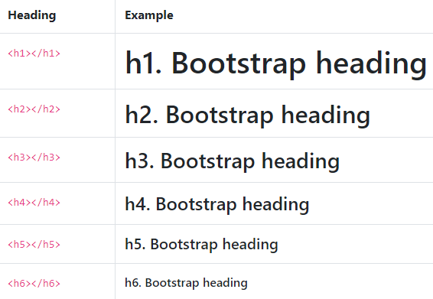
Headings #1

Slide 14
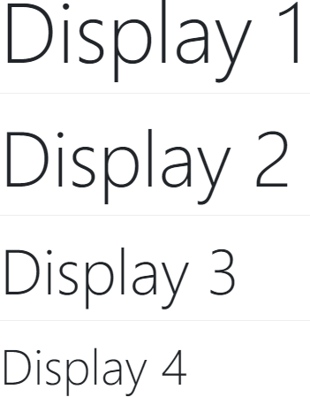

Headings #2

Slide 15
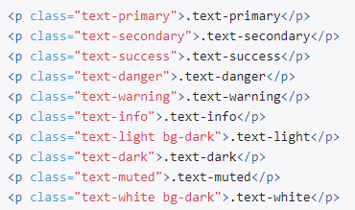
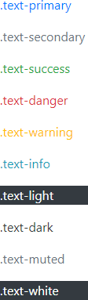
Colours text Styles

Slide 16
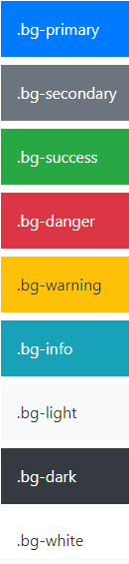
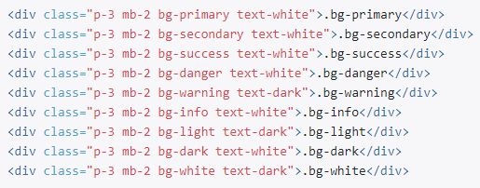
Colours Shape Fill Styles

Slide 17
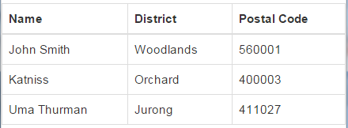
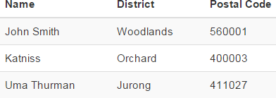
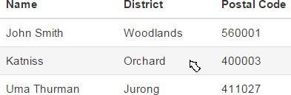
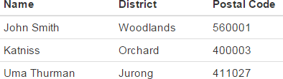
Table Styles #1
.table-striped
.table-bordered
.table-hover
.table-sm

Slide 18
Table Styles #2
Added a new .table-inverse option.
Added table header 2 modifiers:
.thead-default
.thead-inverse.
5 Contextual classes:
.table-active
.table-success
.table-warning
.table-danger
.table-info

Slide 19
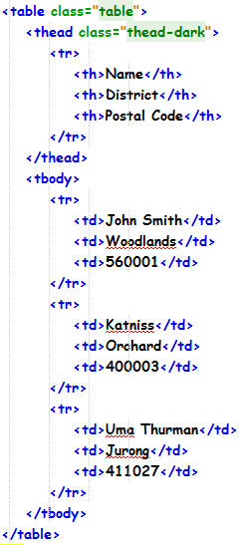
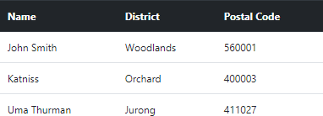
Tables Style (Black Shape Fill)

Slide 20
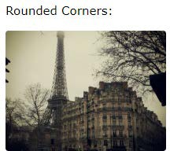
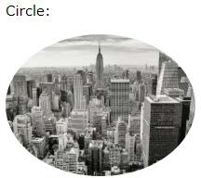
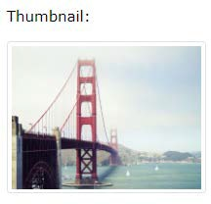
4 Images Style
<img src ="cinqueterre.jpg" class="rounded" alt="Cinque Terre">
<img src ="cinqueterre.jpg" class="rounded-circle" alt="Cinque Terre">
<img src ="cinqueterre.jpg" class="img-thumbnail" alt="Cinque Terre">
Responsive Images
Images come in all sizes . So do screens . Responsive images automatically adjust to fit the size of the screen
<img src ="cinqueterre.jpg" class="img-fluid" alt="Chania">

Slide 21
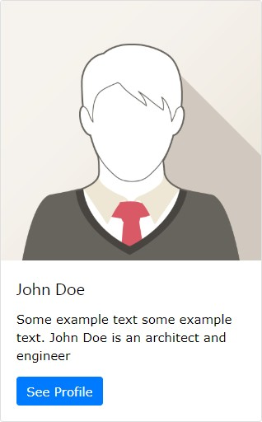
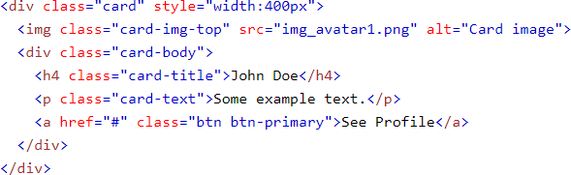
Cards
bordered box with some padding around its content.
includes options for headers, footers, content, colors, etc.

Slide 22


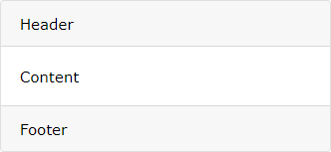
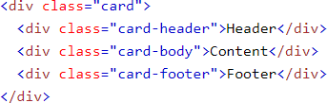
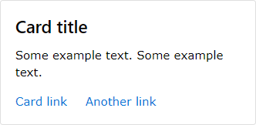
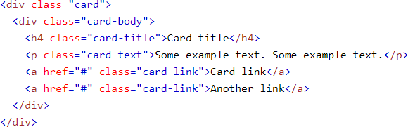
Cards Examples

Slide 23
9 Spacing Utilities
Padding | p
Margin | m
Margin-top or padding-top | t
Margin-bottom or padding-bottom | b
Margin-left or padding-left | l
Margin-right or padding-right | r
for classes that set both *-left and *-right | x
for classes that set both *-top and *-bottom | y
for the classes that set on all four sides (margin and padding) | blank
Example
mt-0 means margin-top: 0px
ml-1 means margin-left: ($spacer * .25)
px-2 means padding-left: ($spacer * .5) and padding-right: ($spacer * .5)

Slide 24
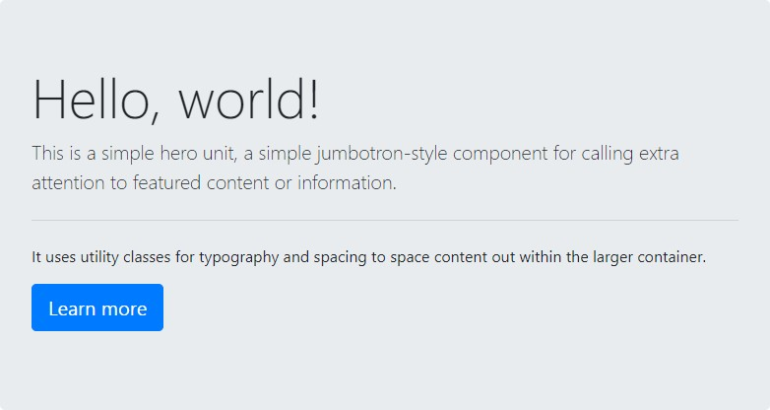
Jumbotron
A jumbotron indicates a big grey box for calling extra attention to some special content/information.

Slide 25
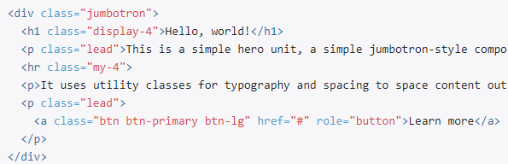
Jumbotron Code

Slide 26
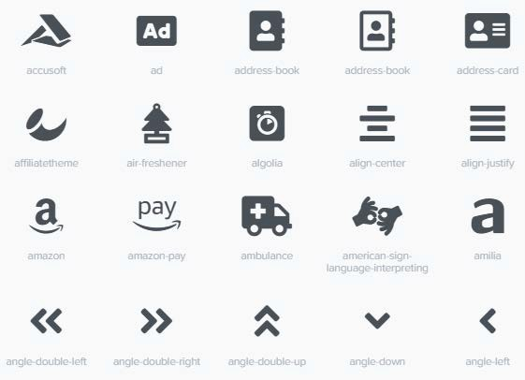
Font Awesome
Font Awesome is a font and icon toolkit.
Made by Dave Gandy for use with Twitter Bootstrap, and later was incorporated into the BootstrapCDN

Slide 27

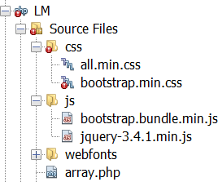

Font Awesome
How to use?
Link the stylesheet via CDN:
<link rel="stylesheet" href="https://use.fontawesome.com/releases/v5.3.1/css/all.css">
Download the zip file from https://fontawesome.com and extract the css and webfonts/ folder.
Link the all.min.css to your page
Add the icon:
<i class="fas fa-user"></i>

Slide 28
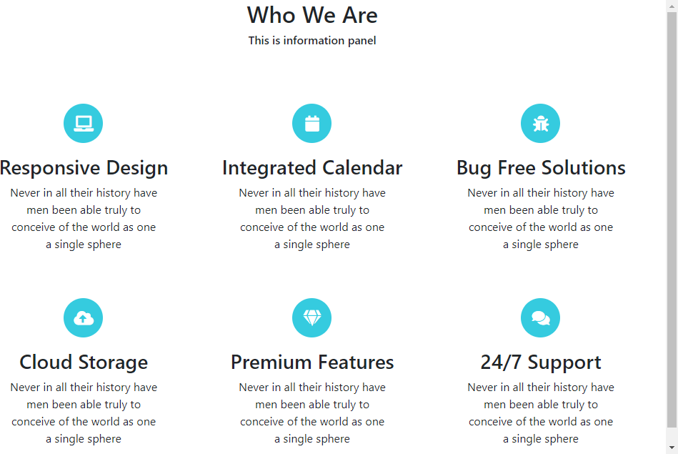
about.html
2 rows 3 columns

Slide 29
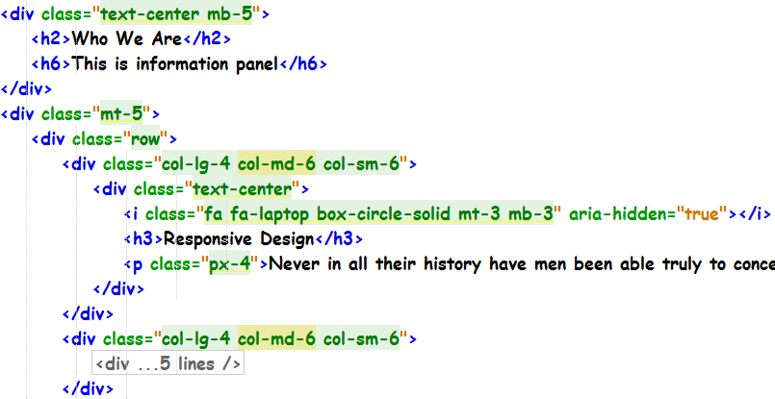
about.html

Slide 30
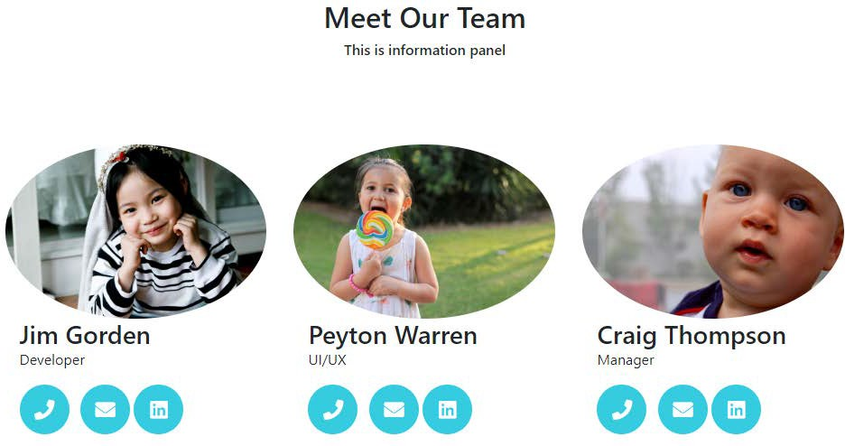
team.html
1 row 3 columns

Slide 31
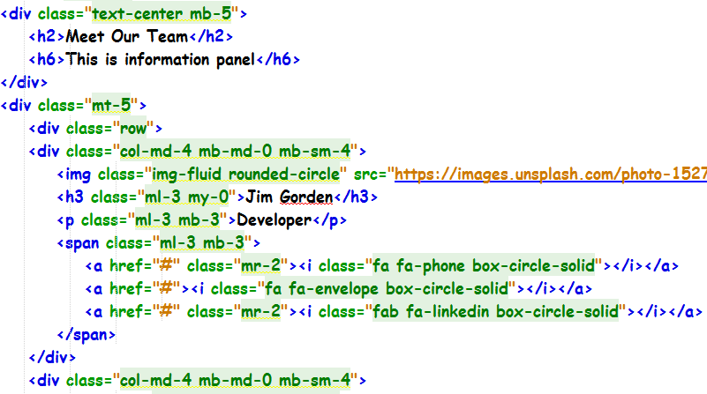
team.html

Slide 32

contact.html
1 row 2 columns

Slide 33
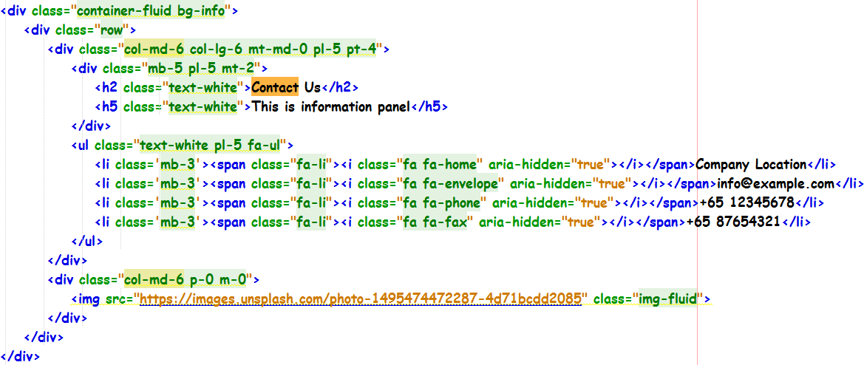
contact.html

Slide 34
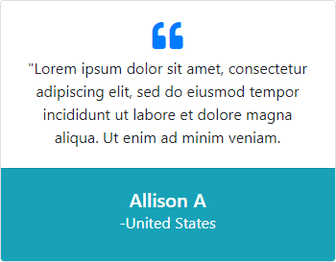
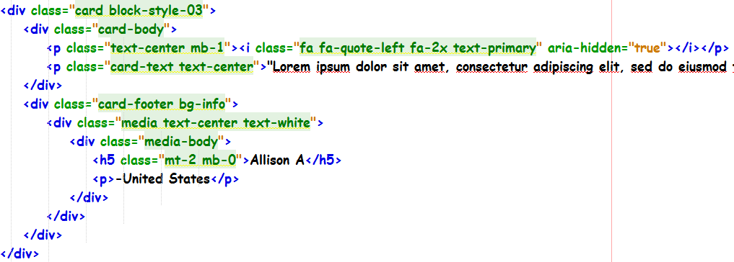
testimonials.html

Slide 35
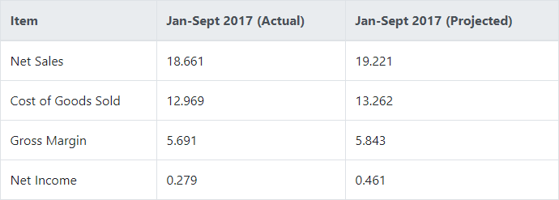
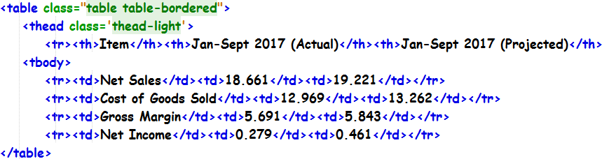
testimonials.html

Slide 36
Lesson Summaries:
Recognise the browser support of CSS3 and HTML5 features.
Download bootstrap libraries and apply to web pages
Apply <meta> viewport element to enable page responsiveness for various screen sizes.
Recognise the various Bootstrap CSS features, components and plugins
Apply the Bootstrap grid system for various grid layouts
Apply Bootstrap Typography, Tables, Cards, Images, Jumbotron, Spacing Utilities to build web pages

